Slide 1


Probabilistic Predictions of Severe Weather with Machine Learning
Aaron J. Hill and Russ S. Schumacher
Colorado State University
Along with NOAA partners: Israel Jirak (SPC), Mark Klein and Jim Nelson (WPC)​
And contributions from Allie Mazurek (CSU) and Hanna McDaniel (FSU)​
Indianapolis Regional WFOs Training Session
Wednesday April 12th 2023
Research supported by NOAA JTTI grants NA20OAR4590350 and NA21OAR4590187 ​

Slide 2
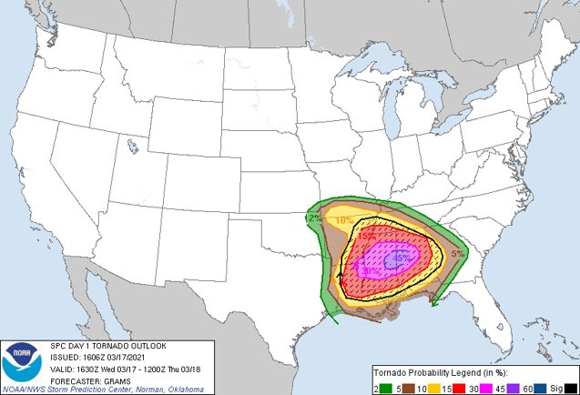
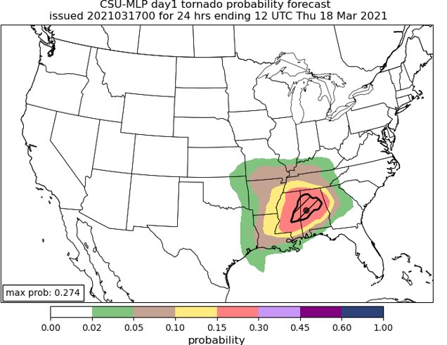

Question: How can machine learning (ML) be leveraged for high-impact weather forecasting?
Real-time forecast graphics:
http://schumacher.atmos.colostate.edu/hilla/csu_mlp/​
Colorado State University Machine Learning Probabilities
(CSU-MLP)
Hill et al. (2020, MWR); Hill et al. (2023, WAF) ​
Notes:
ML is becoming more prevalent in weather forecasting as an alternative means to leverage the numerous and vast datasets that dynamical models produce
As one example, there are now (that we know of) three separate ML systems that forecast severe weather by emulating Storm Prediction Center outlooks
These are based on the HREF, HRRR, and GEFS (loken, Sobash, Hill)

Slide 3
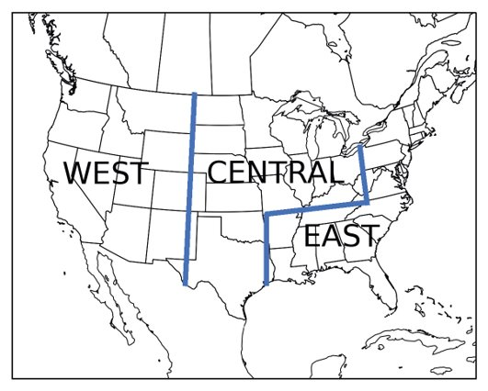
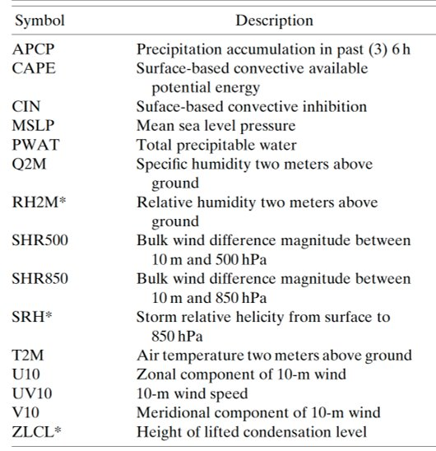
Approach
Input: NOAA’s FV3-GEFS Reforecast Dataset (Hamill et al. 2022): 5 members, matches current GEFSv12 ​
Use many atmospheric fields as predictors (see table below), train random forest models over 3 distinct regions
​
We use April 2003 – April 2012 as the training period (~9 yrs)​
Observations from SPC’s severe weather reports database (i.e., Storm Data)​
Forecasts made for individual hazards (tornado, hail, wind) on days 1-3, and aggregate severe threat on days 3-8 ​
Guidance being evaluated in SPC operations since mid-2021​
​
Notes:
One of the reasons these types of systems are being pursued is the operational benefit that might be incurred
In Hill et al. 2020, SPC outlooks and RF-based forecasts of severe weather (individual hazards as well as aggregate hazards) were evaluated against one another.
One important outcome of that work was that a combination of SPC and RF outlooks (i.e., blend) often outperformed either individual component
In other words, the incorporation (in our example a statistical manner) of ML-based guidance was improving upon the human forecasts
One additional outcome, that motivates the rest of this presentation, is the benefit was that was seen beyond day 1
ML forecasts (and the blends) were improved at days 2 and 3 over SPC outlooks

Slide 4
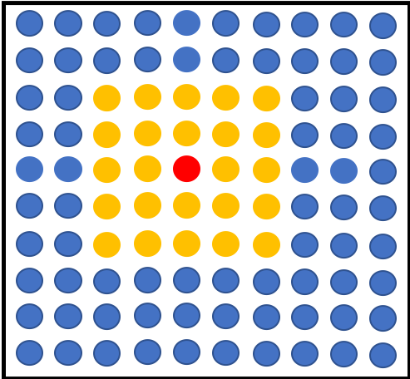
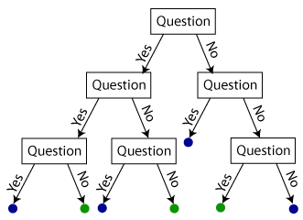
Random Forests
Forecast point
Temperature at (-2, -1) > 20 C?
A set of decision trees that contain a series of yes/no questions based on the inputs that allow traversal of the tree
Corresponding events of severe weather are assigned to the “leaf” nodes​
Relative frequency of events in the forest is the forecast probability​
Python package "determines" best predictors that discriminate events​
…..
CAPE at (1, -2) > 500 J/kg?
Probability of severe hail
50%

Slide 5
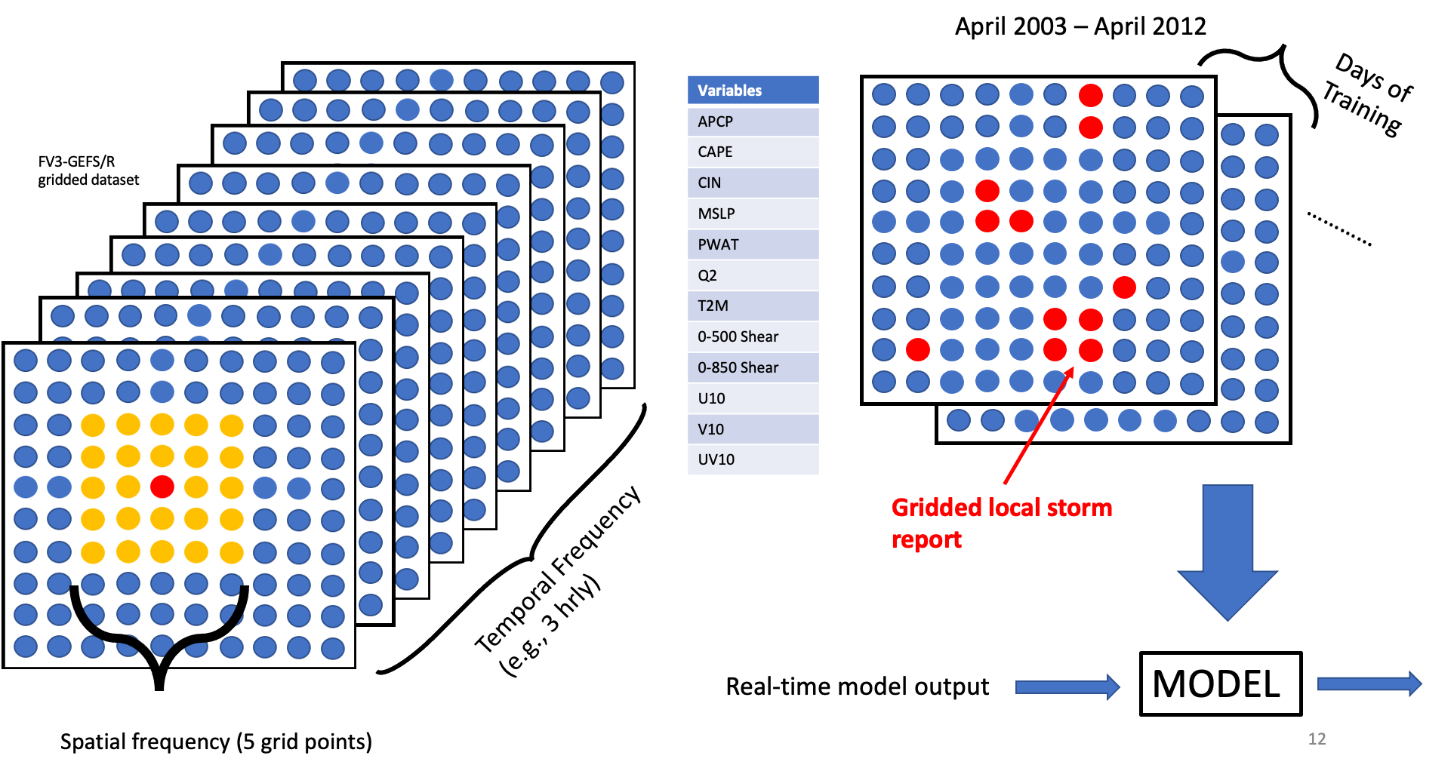
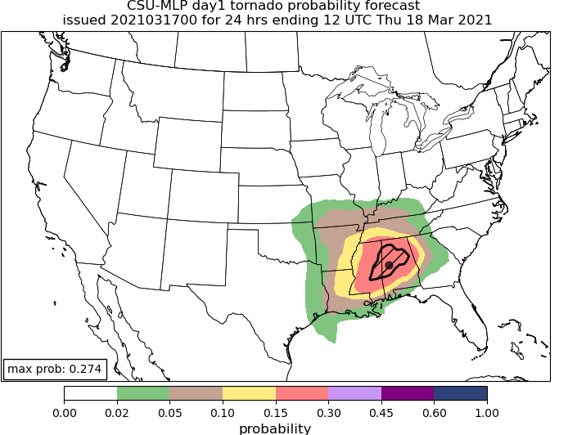
Random Forest Configuration
Gridded rainfall
observation
Gridded local storm report

Slide 6
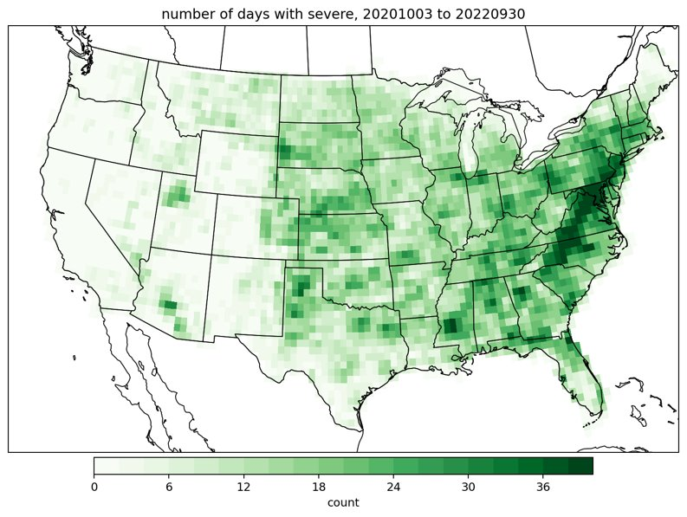
Methods
CSU-MLP forecasts are evaluated against gridded severe weather reports​
Evaluation from 3 October 2020 through 30 September 2022​
Forecast performance is compared to SPC’s outlooks, issued at 1300 UTC (day 1), 0700 UTC (day 2), and 0730/0830 UTC (day 3)​
CSU-MLP forecasts are discretized to the SPC outlook probability categories
Number of days with severe weather in the analysis period​

Slide 7
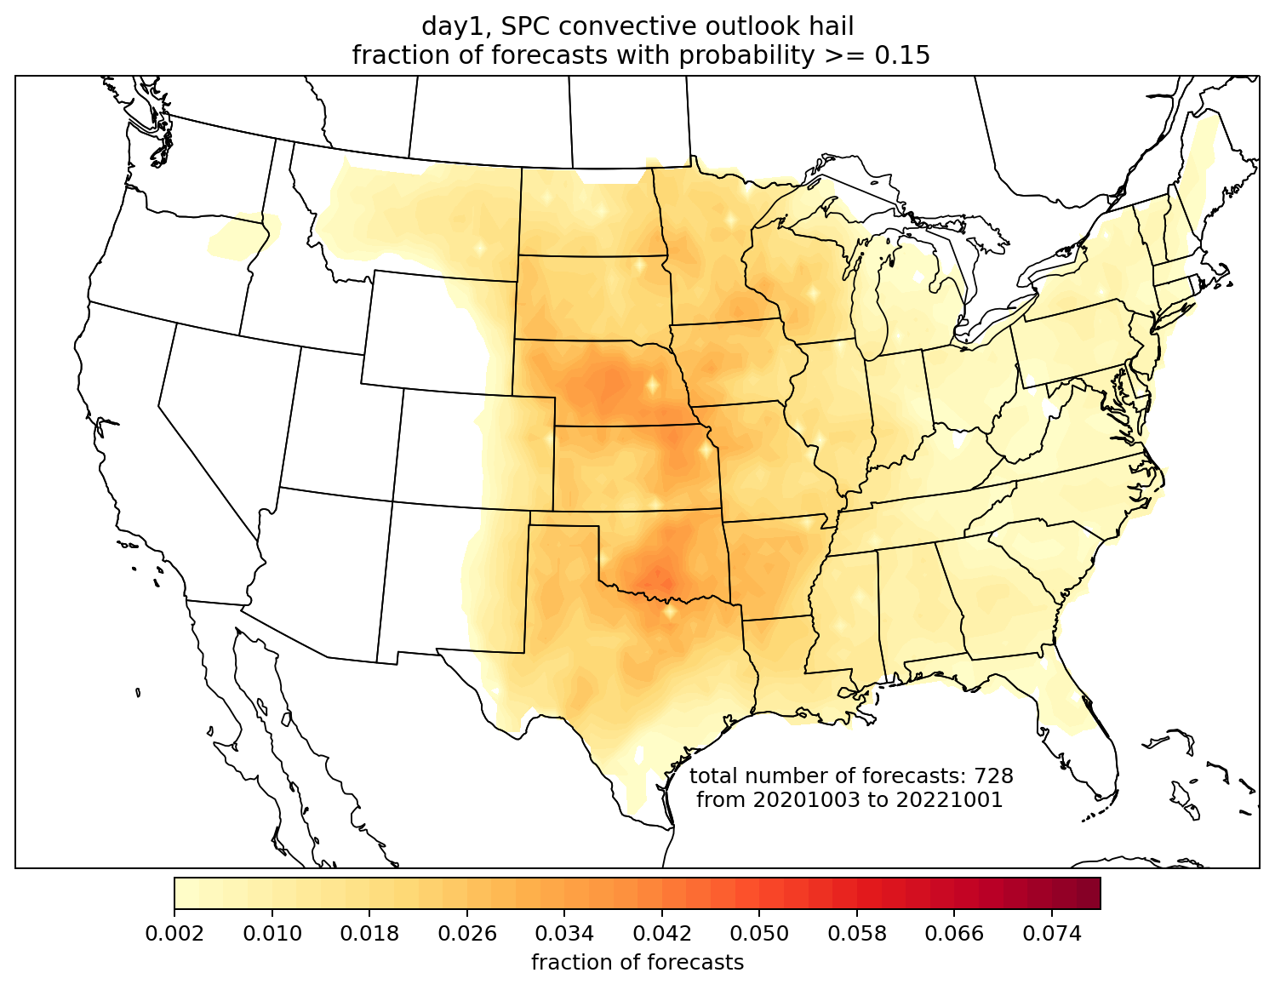
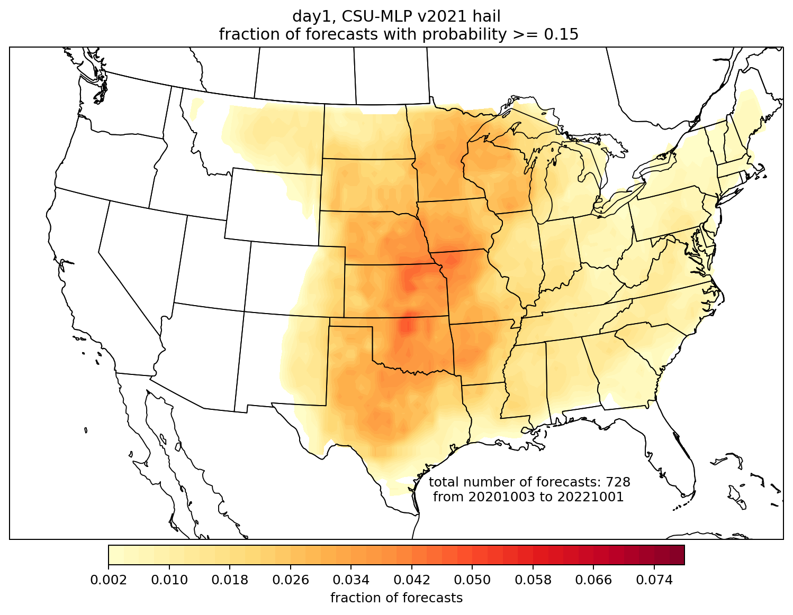
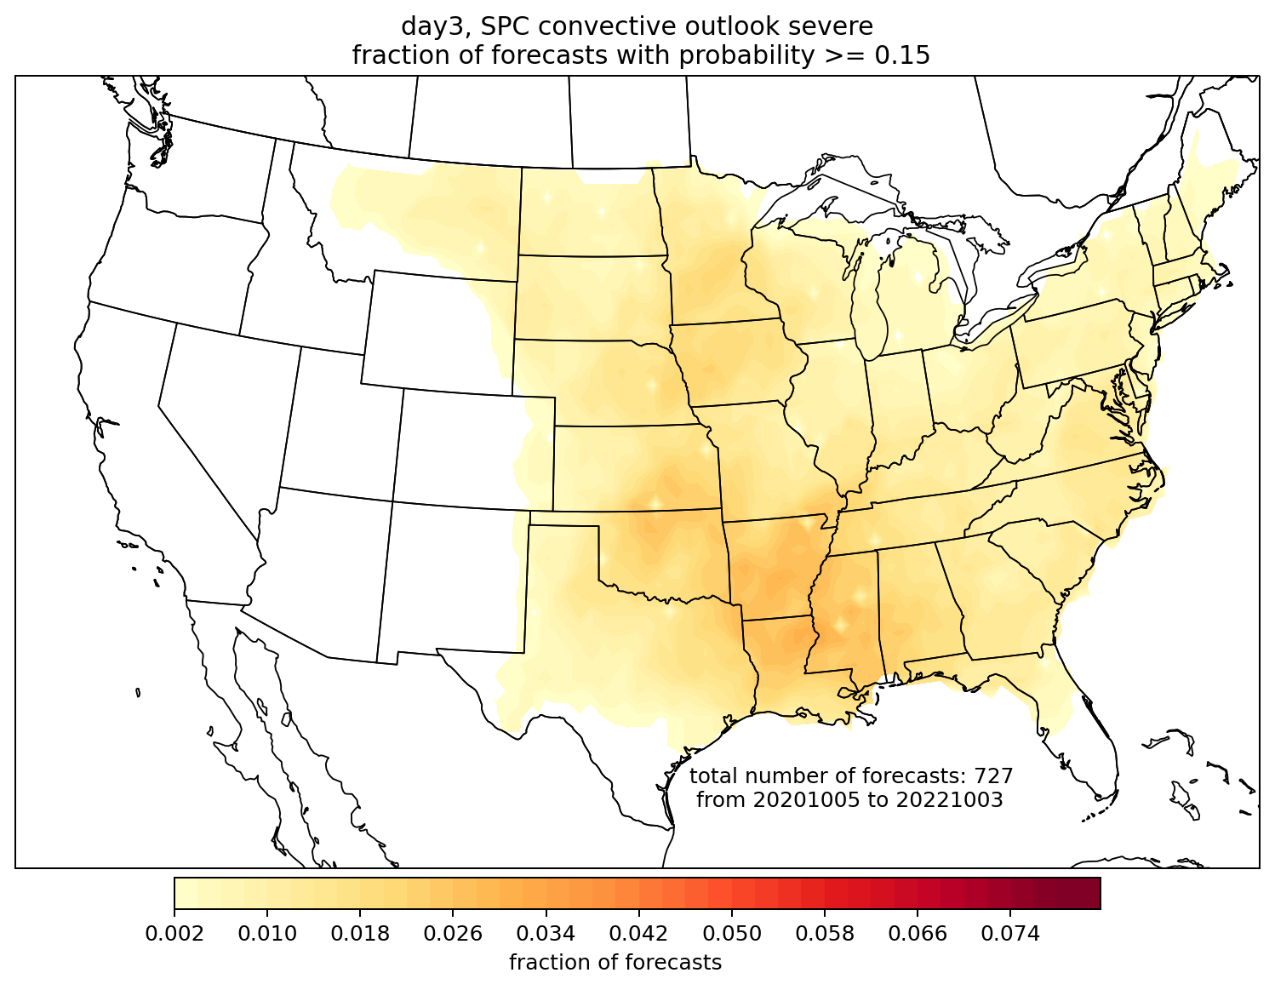
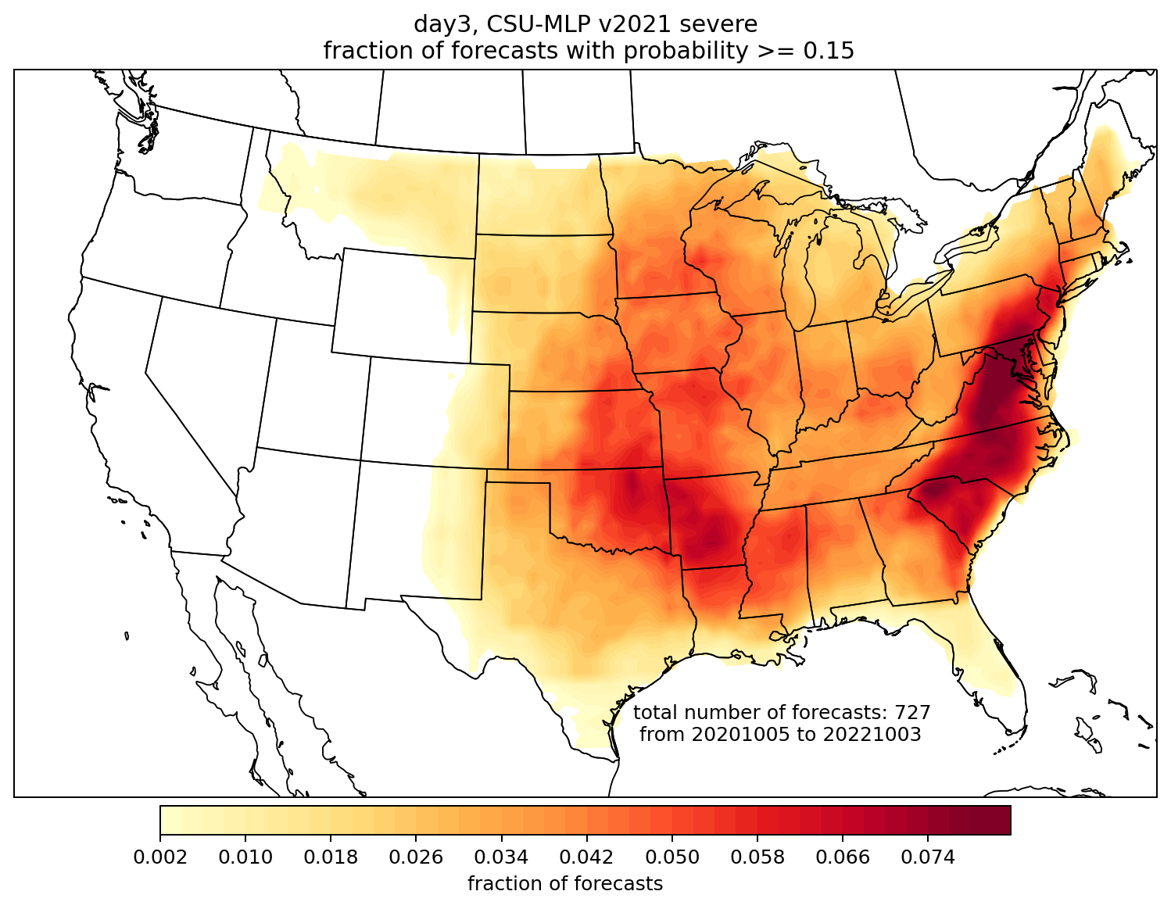
CSU-MLP forecast probabilities are issued at similar frequency to SPC on day 1; much more frequently on day 3
Day 1 hail, 15%
SPC
CSU-MLP
Day 3,
all severe, 15%
SPC
CSU-MLP

Slide 8
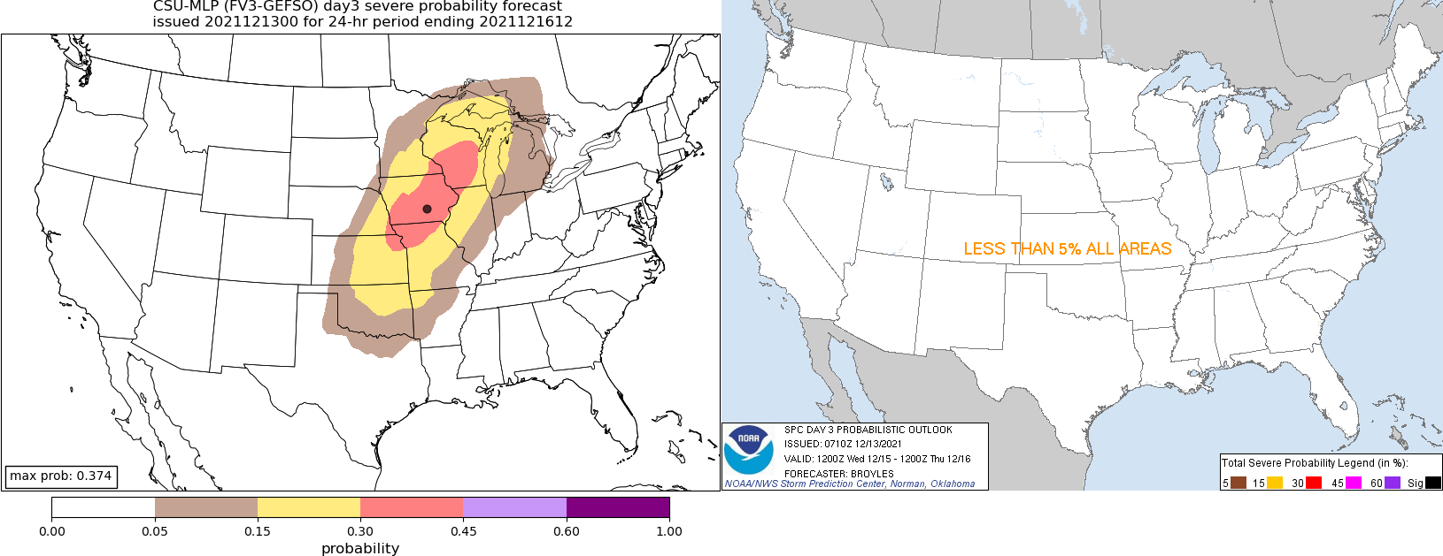
First example case: 15-16 December 2021 outbreak
SPC Day 3 outlook, issued 0710 UTC 13 December
CSU-MLP day 3 forecast from 0000 UTC GEFS

Slide 9
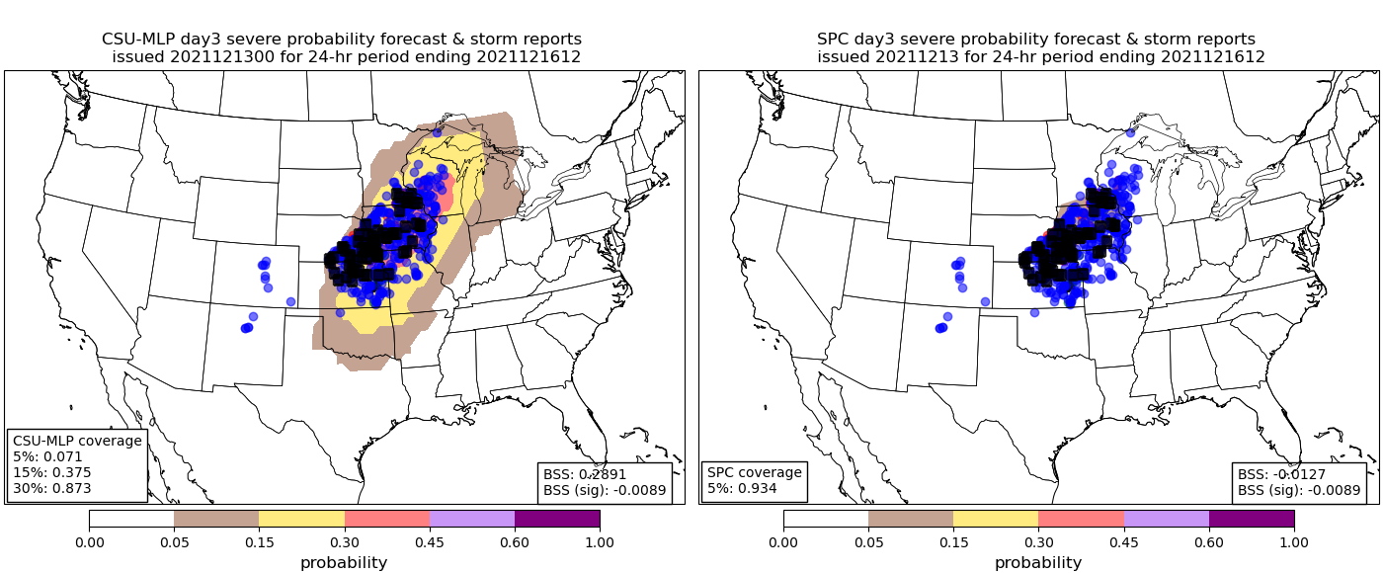

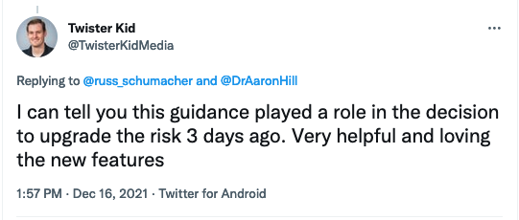
15-16 December 2021 outbreak: home run for CSU-MLP
SPC Day 3 outlook, issued 1815 UTC 13 December
CSU-MLP day 3 forecast from 0000 UTC GEFS
SPC BSS = 0.0
CSU BSS = 0.34

Slide 10
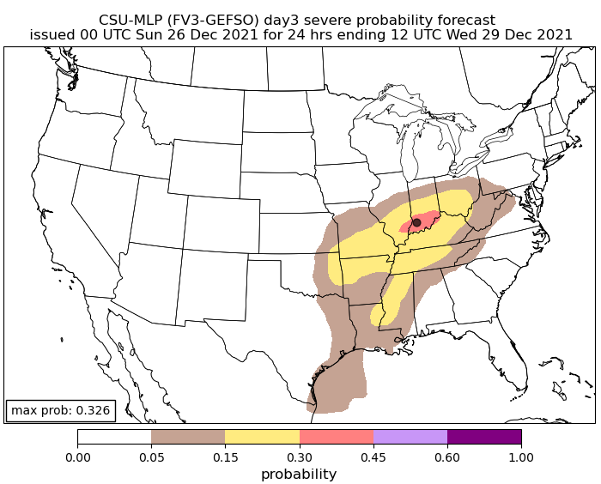
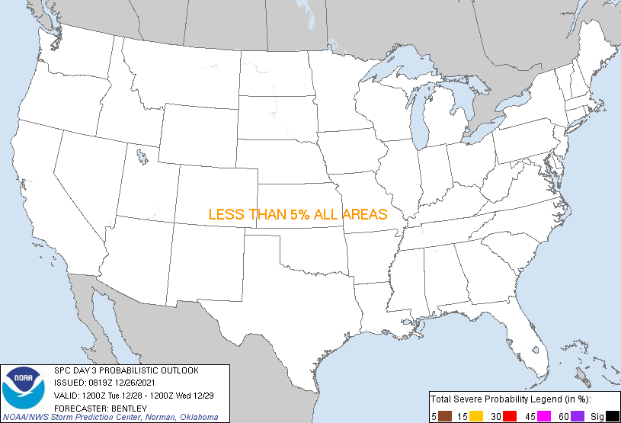
Second example case: 28-29 December 2021
SPC Day 3 outlook, issued 0819 UTC 26 December
CSU-MLP day 3 forecast from 0000 UTC GEFS

Slide 11
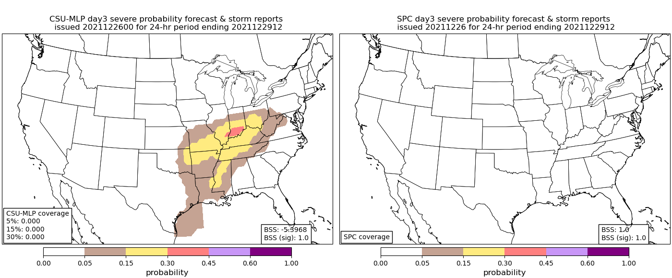

28-29 December 2021: swing and a miss
SPC Day 3 outlook, issued 0710 UTC 13 December
CSU-MLP day 3 forecast from 0000 UTC GEFS
@PitchingNinja
SPC BSS = 0.0
CSU BSS = -7.42

Slide 12
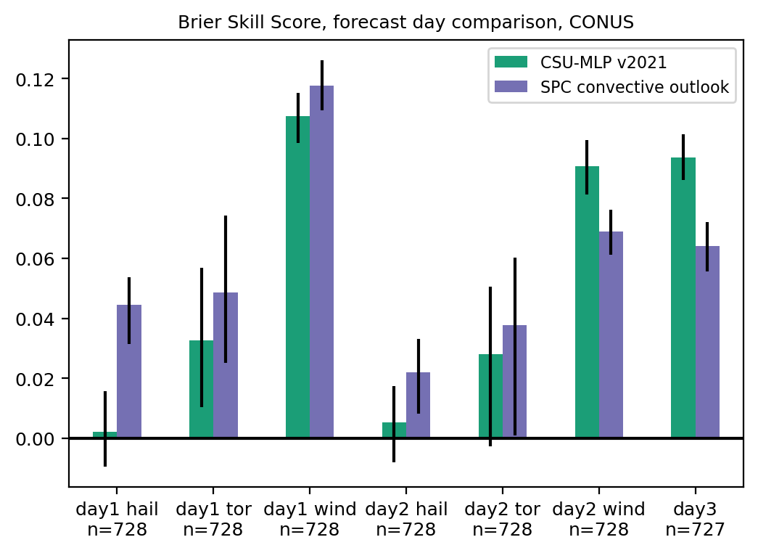
Brier skill score, by day and hazard
DAY 3
DAY 1
DAY 2
HAIL
TOR
WIND
HAIL
TOR
WIND
ALL
SPC’s expertise really shows on day 1: they have higher skill for all hazards
Both SPC and CSU-MLP were most skillful for wind, least for hail
CSU-MLP was more skillful for day 2 wind and day 3 aggregate severe

Slide 13
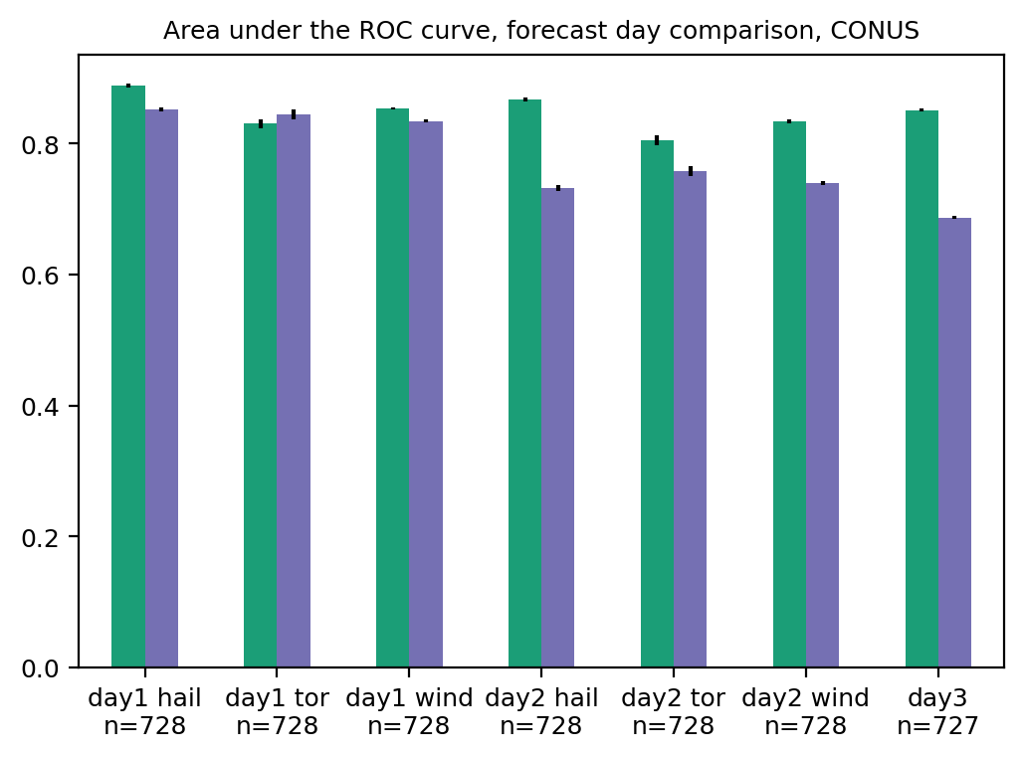
Area under the ROC curve, by day and hazard
DAY 1
DAY 2
DAY 3
ROC area for hail forecasts is quite high even though BSS was low - suggests potential for further improvement with better calibration

Slide 14
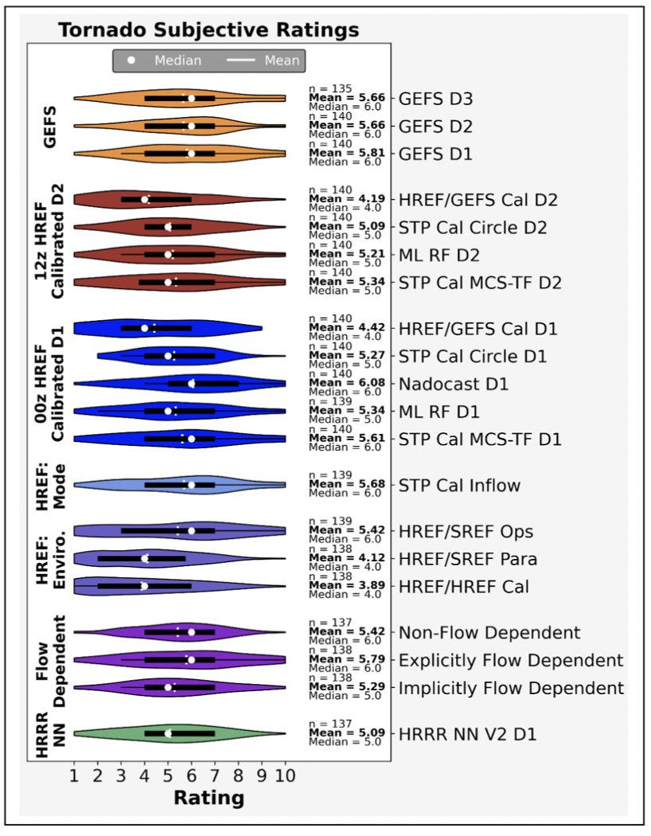
How do Hazardous Weather Testbed participants view this guidance?
“Despite using a coarse global ensemble as input, the GEFS tornado guidance received relatively high ratings from Day 3 to Day 1. In aggregate, the GEFS Day-3 product scored identically to the GEFS Day-2 product.”
“The day 1 and 2 GEFS [hail] forecasts performed particularly well relative to the other guidance products, especially considering the coarse global ensemble input. With that said, some participants felt that the GEFS products covered too large of areas, particularly at shorter lead times.”
https://hwt.nssl.noaa.gov/sfe/2022/docs/HWT_SFE_2022_Prelim_Findings_FINAL.pdf

Slide 15
How do Hazardous Weather Testbed participants view this guidance?
“Despite using a coarse global ensemble as input…”
“…especially considering the coarse global ensemble input…”
There is a great deal of information in large-scale environments!
https://hwt.nssl.noaa.gov/sfe/2022/docs/HWT_SFE_2022_Prelim_Findings_FINAL.pdf

Slide 16
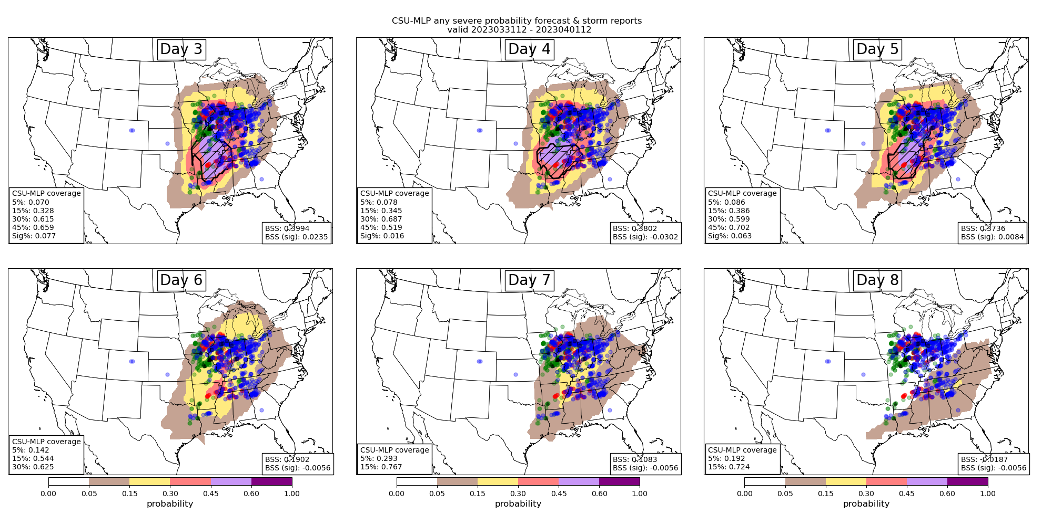
31 March 2023 outbreak

Slide 17
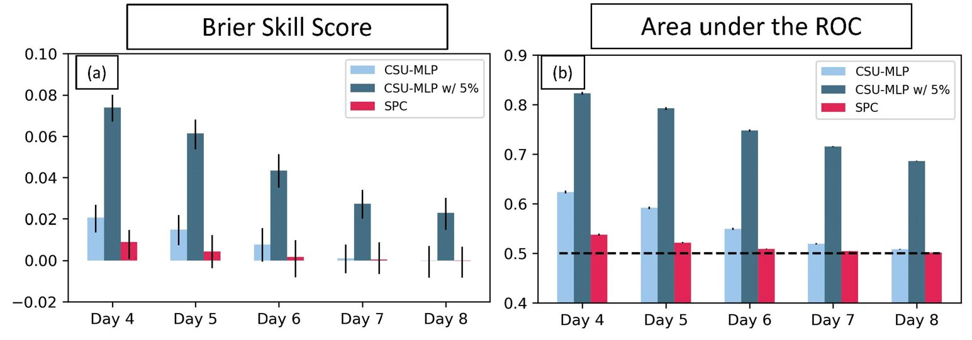
Forecast skill and discrimination out to day 6
Includes 5% contour in discretization
October 2020 – December 2022 verification

Slide 18
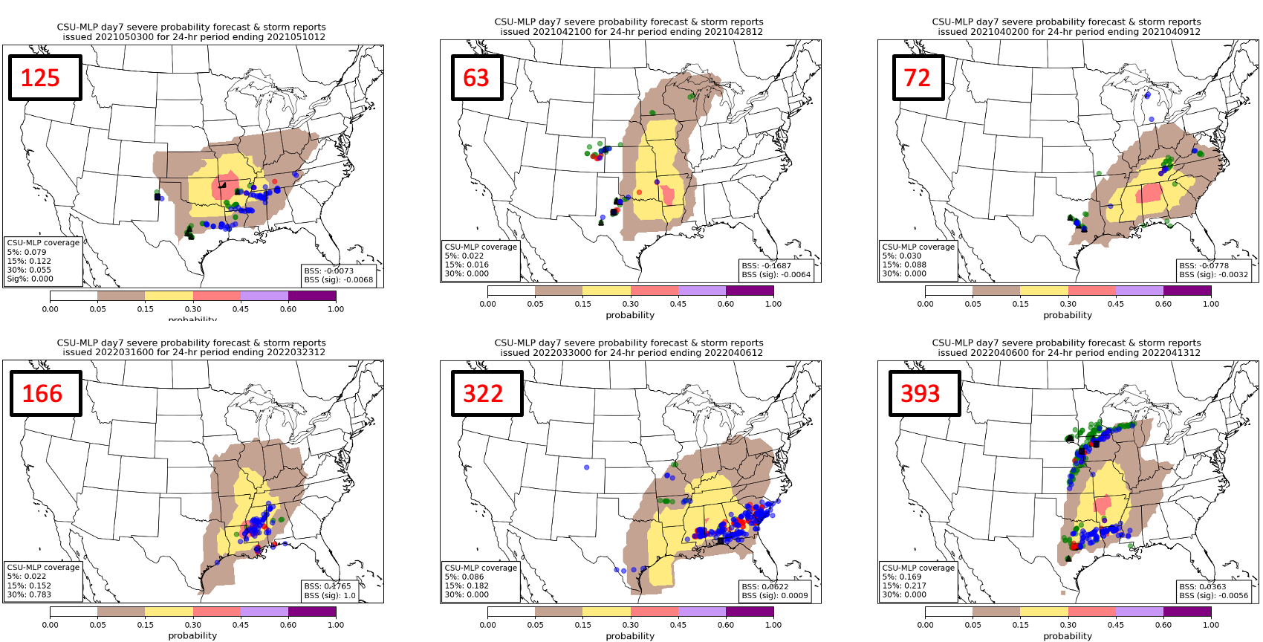
Are high impact days connected to higher probabilities at longer lead times?

Slide 19
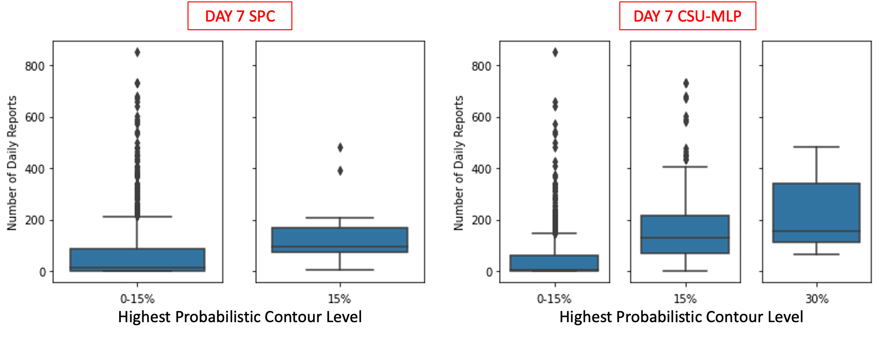
Can SPC exploit this information? Forecasters already do in some respects…

Slide 20
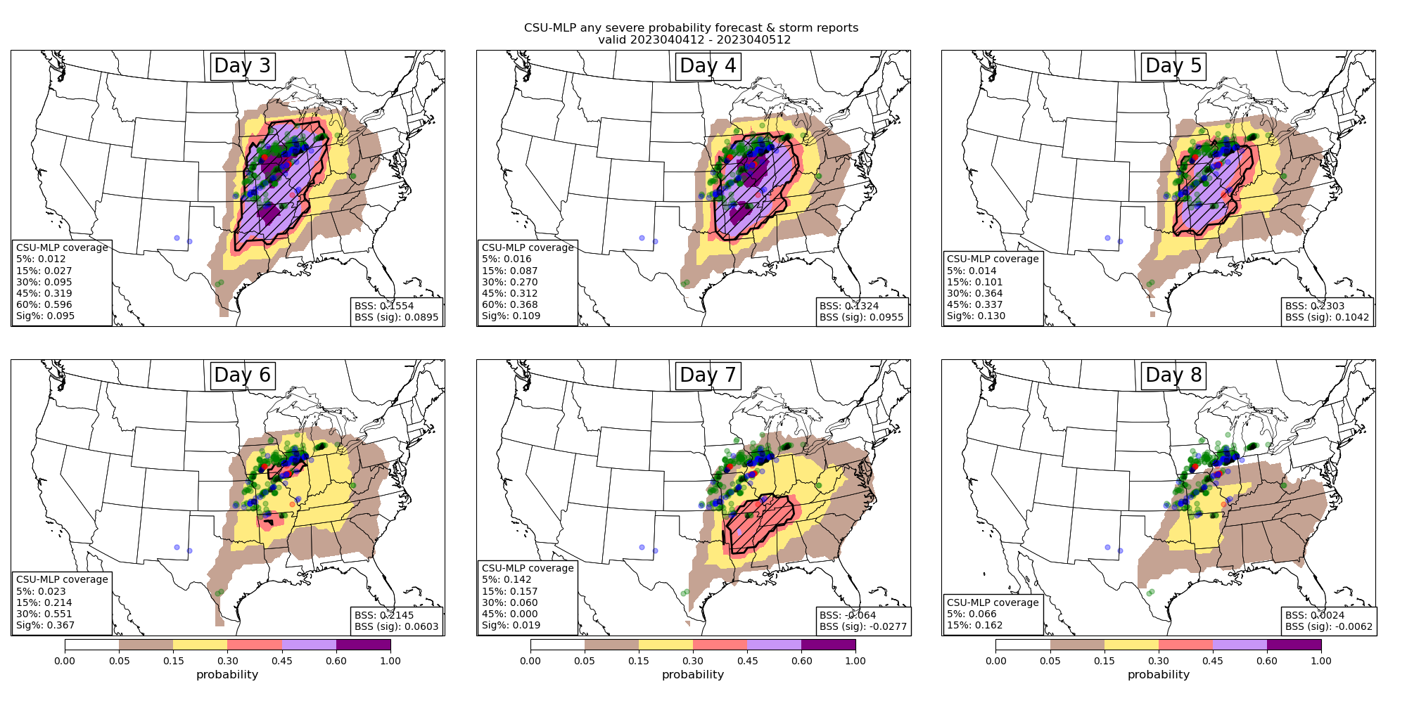
4 April 2023 supposed-to-be outbreak

Slide 21
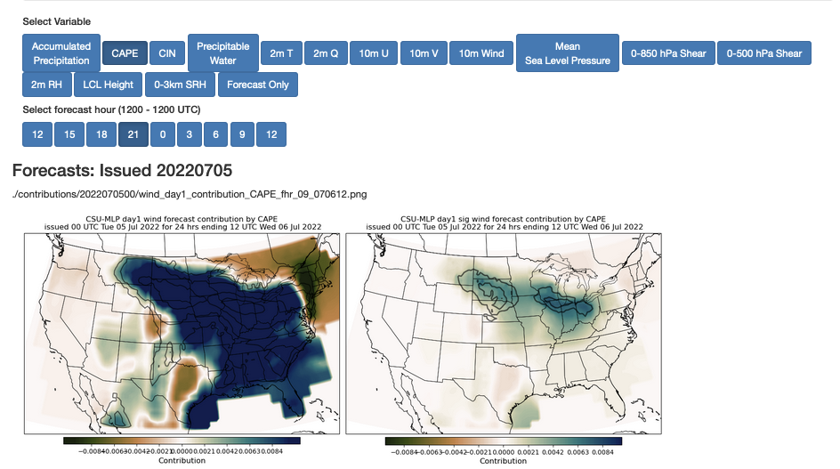
The future: diagnosis of how environmental parameters are influencing the forecast
Work by Aaron Hill and REU student Hanna McDaniel, using Tree Interpreter package

Slide 22
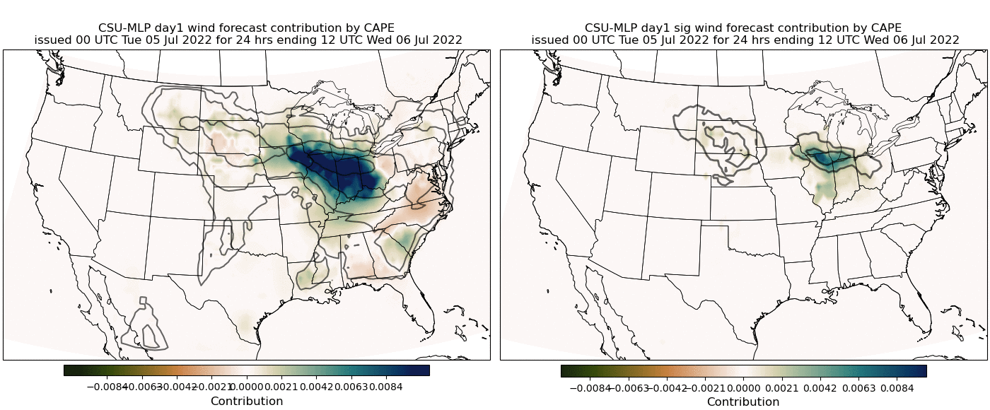
The future: diagnosis of how environmental parameters are influencing the forecast
Forecast of 5-6 July 2022 South Dakota derecho
Solid contours: CSU-MLP probability forecast
Shading: Contribution to that probability by CAPE
Work by Aaron Hill and REU student Hanna McDaniel, using Tree Interpreter package

Slide 23
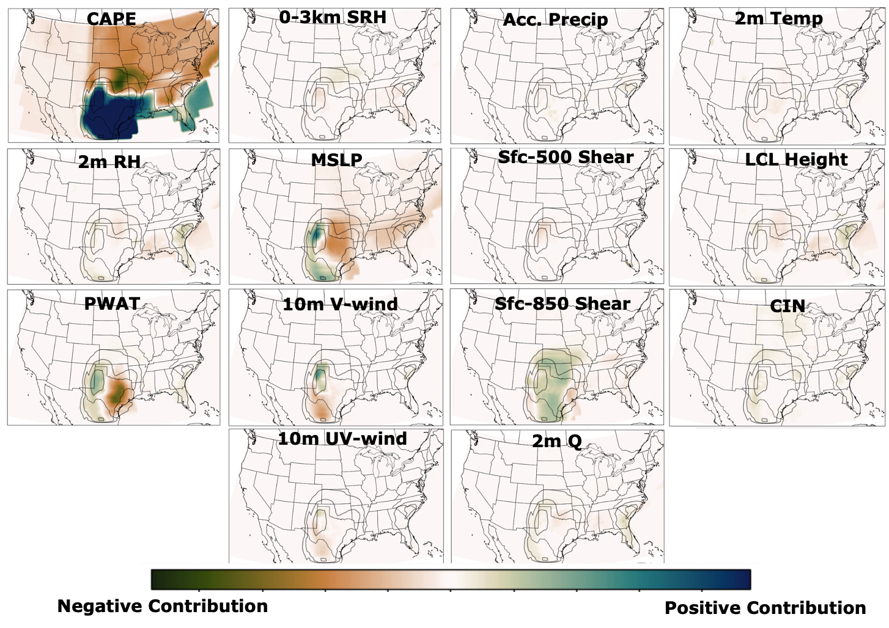
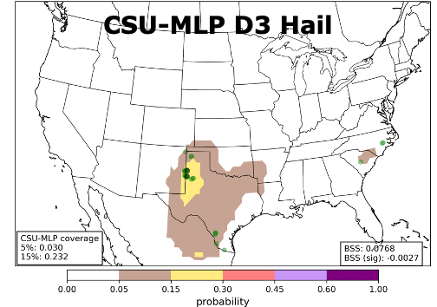
The future: diagnosis of how environmental parameters are influencing the forecast
Example: Day 3 hail forecast contributions for 23 May 2022 at forecast hour 2100 UTC
Can spatially interpret which fields are supplying key information to the forecast probs

Slide 24
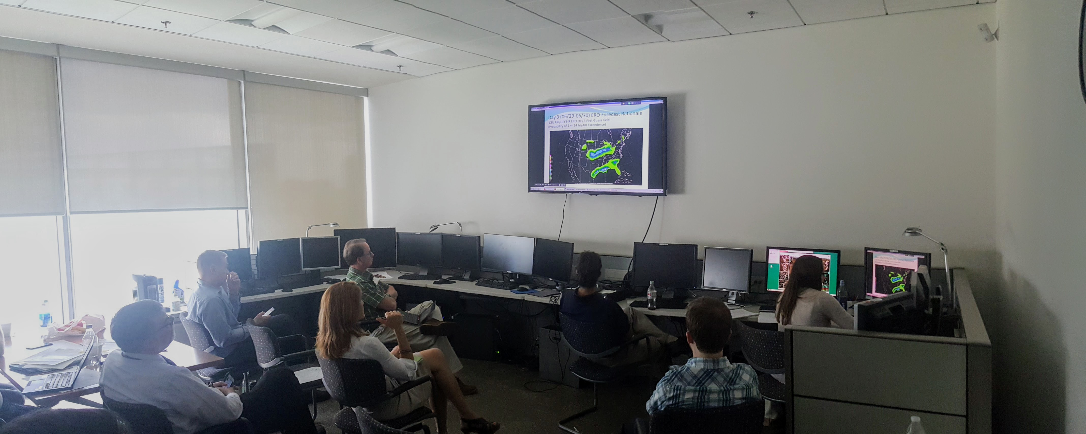
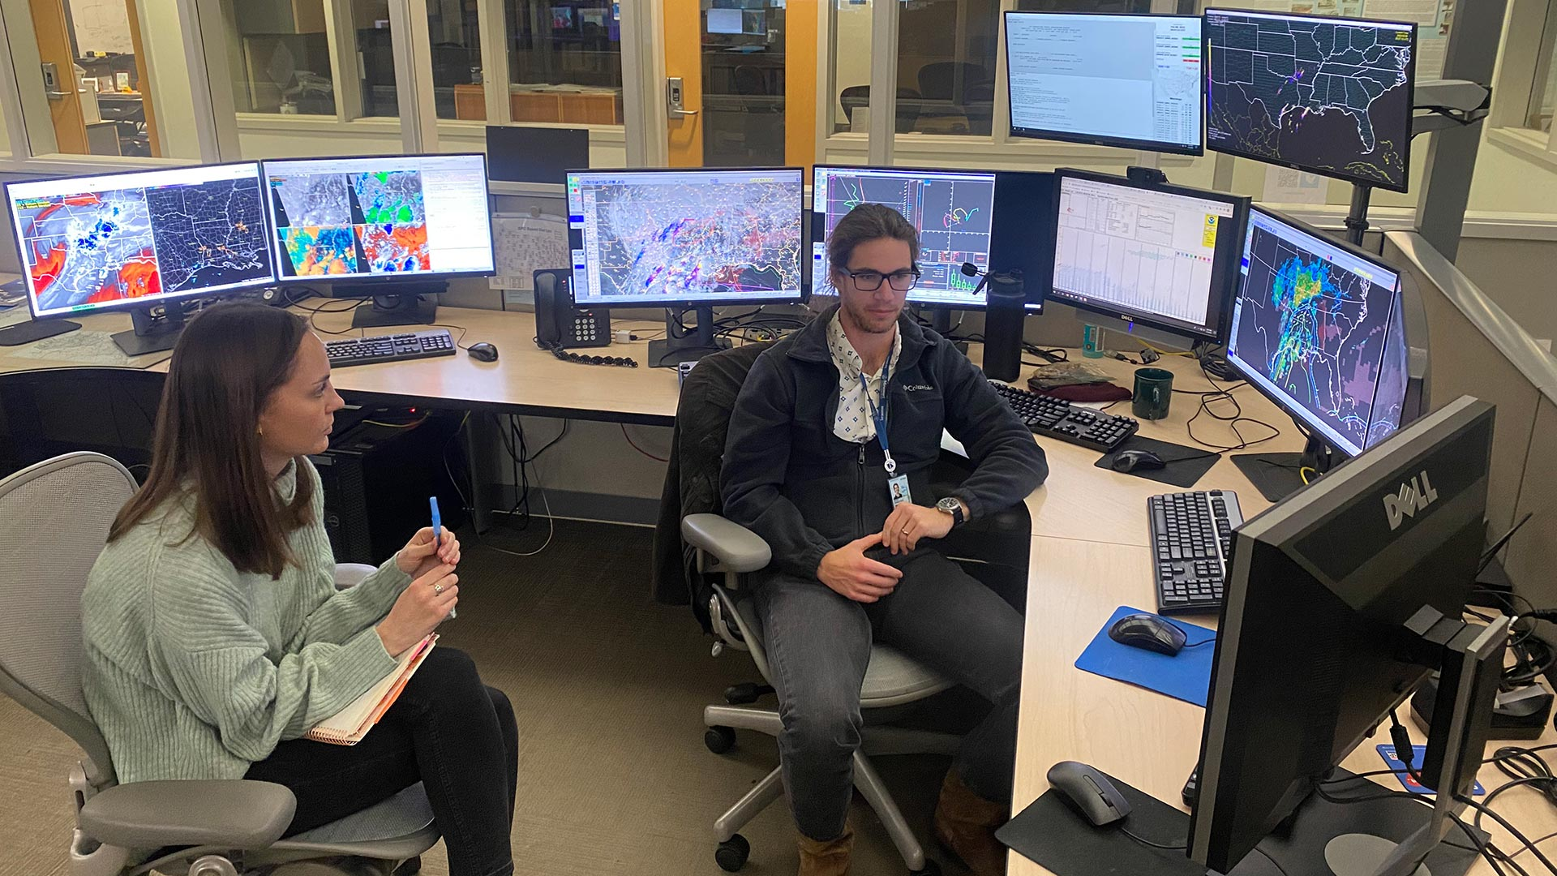
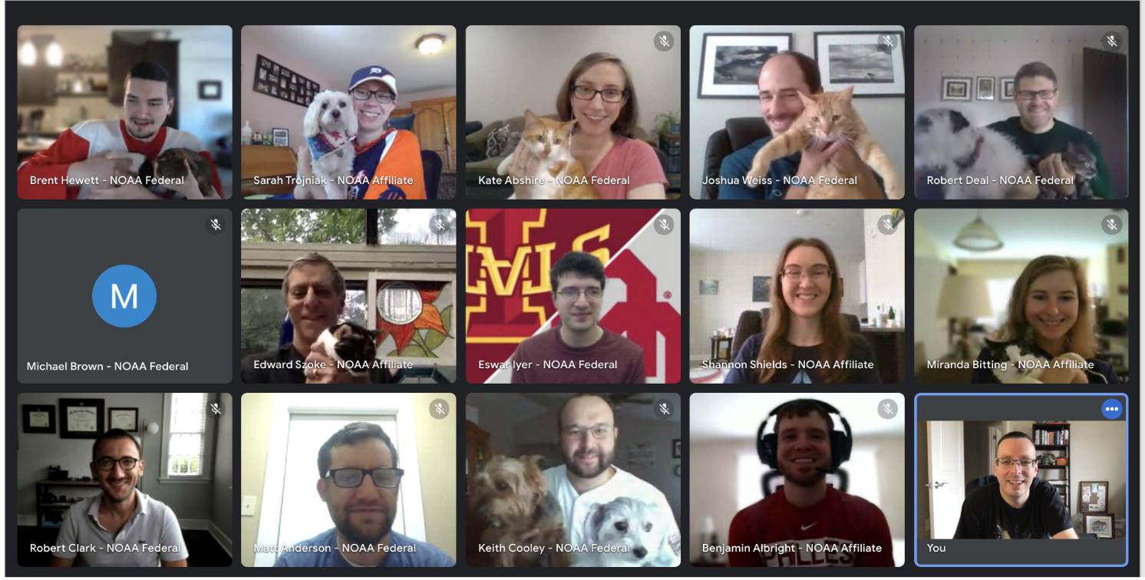
Collaboration with forecasters has been key to the improvement of these ML-based systems!

Slide 25

Summary
Machine learning techniques can help in post-processing NWP output to yield useful “first guess” guidance for operations
ML models for severe weather are skillful, and competitive with operational outlooks – especially beyond day 1
Plenty of opportunities for further advances, both in the forecasts themselves, and how they can be applied: what’s the best way to make them useful and trustworthy for forecasters?
Thank you!
russ.schumacher@colostate.edu
aaron.hill@colostate.edu
Real-time forecast graphics: http://schumacher.atmos.colostate.edu/hilla/csu_mlp/
Contact us if interested in gridded output!

